Slide 1
Open Education in Health Programs
March 05,2020
Dr. FAWZI BAROUD
A. Vice President Information Technology
UNESCO Chair in OER

Slide 2


OPEN EDUCATION IN HEALTH PROGRAMS
  What is Open Education
Open education is a philosophy about the way people should produce, share, and build on knowledge.
Open Education covers resources, tools and practices that employ a framework of open sharing to improve educational access and effectiveness.
Open Education seeks to scale up educational opportunities by taking advantage of the power of the internet, allowing rapid and essentially free dissemination, and enabling people around the world to access knowledge, connect and collaborate.

Slide 3
OPEN EDUCATION IN HEALTH PROGRAMS
ES
Open Education Terms
Open Educational Resources (OER)
OpenCourseWare
Open Educational Practice
Open Textbooks
Open Access
Open Pedagogy
= Freely accessible and Openly licensed

Slide 4
OPEN EDUCATION IN HEALTH PROGRAMS
History of Open Education
1969 - UK Open University opens 1983 - Free software movement founded with launch of GNU 1989 - World Wide Web 1997 - MERLOT 1998 - U.S. Copyright Term Extension Act 1998 - “Open content” term is coined and Open Content License released 1999 - Open Publication License released 1999 - Connexions launches (renamed OpenStax in 2012) 2001 - Wikipedia 2001 - Creative Commons founded 2001 - MIT Courseware 2002 - Budapest Open Access Initiative 2002 - Creative Commons licenses launched 2002 - UNESCO coined the name Open Educational Resources 2004 - First annual Open Education Conference 2005 - OpenCourseWare Consortium formed (renamed the Open Education Consortium in 2014) | 2006 - WikiEducator 2007 - Cape Town OER Declaration 2007 - OER Commons 2007 - Wiley and Couros experiment with "open courses" 2008 - Opening Up Education published 2008 - Connectivism and Connected Knowledge 2000 learners participated, leading to the term "massive open online course" or MOOC. 2012 - OpenStax releases first open textbook 2012 - UNESCO OER Paris Declaration 2013 - OERu launched 2017 - UNESCO 2nd World OER Congress 2018 - UNESCO drafting an OER Recommendation 2019 – Final UNESCO recommendations

Slide 5

OPEN EDUCATION IN HEALTH PROGRAMS
OER Milestones
2002
OER was coined at UNESCO's Forum on the Impact of Open Courseware for Higher Education in Developing Countries
2012
Paris OER Declaration
2017
Ljubljana OER Action Plan from awareness to action
2019
UNESCO final OER recommendations approved by all Member States

Slide 6
OPEN EDUCATION IN HEALTH PROGRAMS
Definitions and Scope
Open Educational Resources (OER) are learning, teaching and research materials in any format and medium that reside in the public domain or are under copyright that have been released under an open license, that permit no-cost access, re-use, re-purpose, adaptation and redistribution by others.
Open license refers to a license that respects the intellectual property rights of the copyright owner and provides permissions granting the public the rights to access, re-use, re-purpose, adapt and redistribute educational materials.

Slide 7
OPEN EDUCATION IN HEALTH PROGRAMS
Five Main Objectives:
Building capacity of stakeholders to create, access, re-use, re-purpose, adapt, and redistribute OER
Developing Supportive Policy
Effective, Inclusive and Equitable Access to Quality OER
Nurturing the Creation of Sustainability Models for OER
Promoting and Reinforcing International Cooperation

Slide 8
OPEN EDUCATION IN HEALTH PROGRAMS
OER Examples
Syllabi
Lecture Notes
Full Courses
Books & Textbooks
Images & Illustrations
Homework & Assignments
Audio & Video Lectures
Research Data
Scientific papers

Slide 9


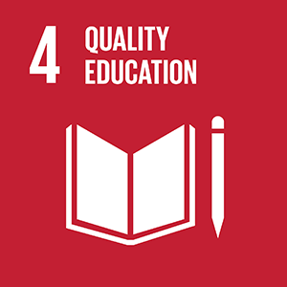

OPEN EDUCATION IN HEALTH PROGRAMS
+
=
OER
Marginal Cost = $0
Open
=
Free
+
Permissions
Needs

Slide 10
OPEN EDUCATION IN HEALTH PROGRAMS
Open
FREE + Permissions: 5Rs
Retain - the right to make, own, and control copies of the content (e.g., download, duplicate, store, and manage)
Reuse - the right to use the content in a wide range of ways (e.g., in a class, in a study group, on a website, in a video)
Revise - the right to adapt, adjust, modify, or alter the content itself (e.g., translate the content into another language)
Remix - the right to combine the original or revised content with other open content to create something new (e.g., incorporate the content into a mashup)
Redistribute - the right to share copies of the original content, your revisions, or your remixes with others (e.g., give a copy of the content to a friend)

Slide 11
OPEN EDUCATION IN HEALTH PROGRAMS
Wiley’s 5 Rs of Openness
الاحتفاظ (Retain)
الحق في انتاج، امتلاك، والتحكم في نسخ مستلة من المحتوى الاصلي
إعادة الاستخدام (Reuse)
الحق في اعادة استخدام المحتوى بعدّة طرق منها داخل الصف، في مجموعات دراسية، على الموقع الالكتروني، أو في مقطع فيديو
المراجعة (Revise)
الحق في تكييف المحتوى بما في ذلك تعديله أو تغييره (على سبيل المثال، ترجمة المحتوى إلى لغة أخرى)
اعادة الدمج (Remix)
الحق في اعادة دمج المحتوى الأصلي أو المعدل مع محتوى آخرلانتاج مادة جديدة
إعادة التوزيع (Redistribute)
الحق في مشاركة نسخ مع الآخرين مستنبطة من المحتوى الأصلي أو من تلك التنقيحات والتعديلات التي ادخلها المؤلف.

Slide 12
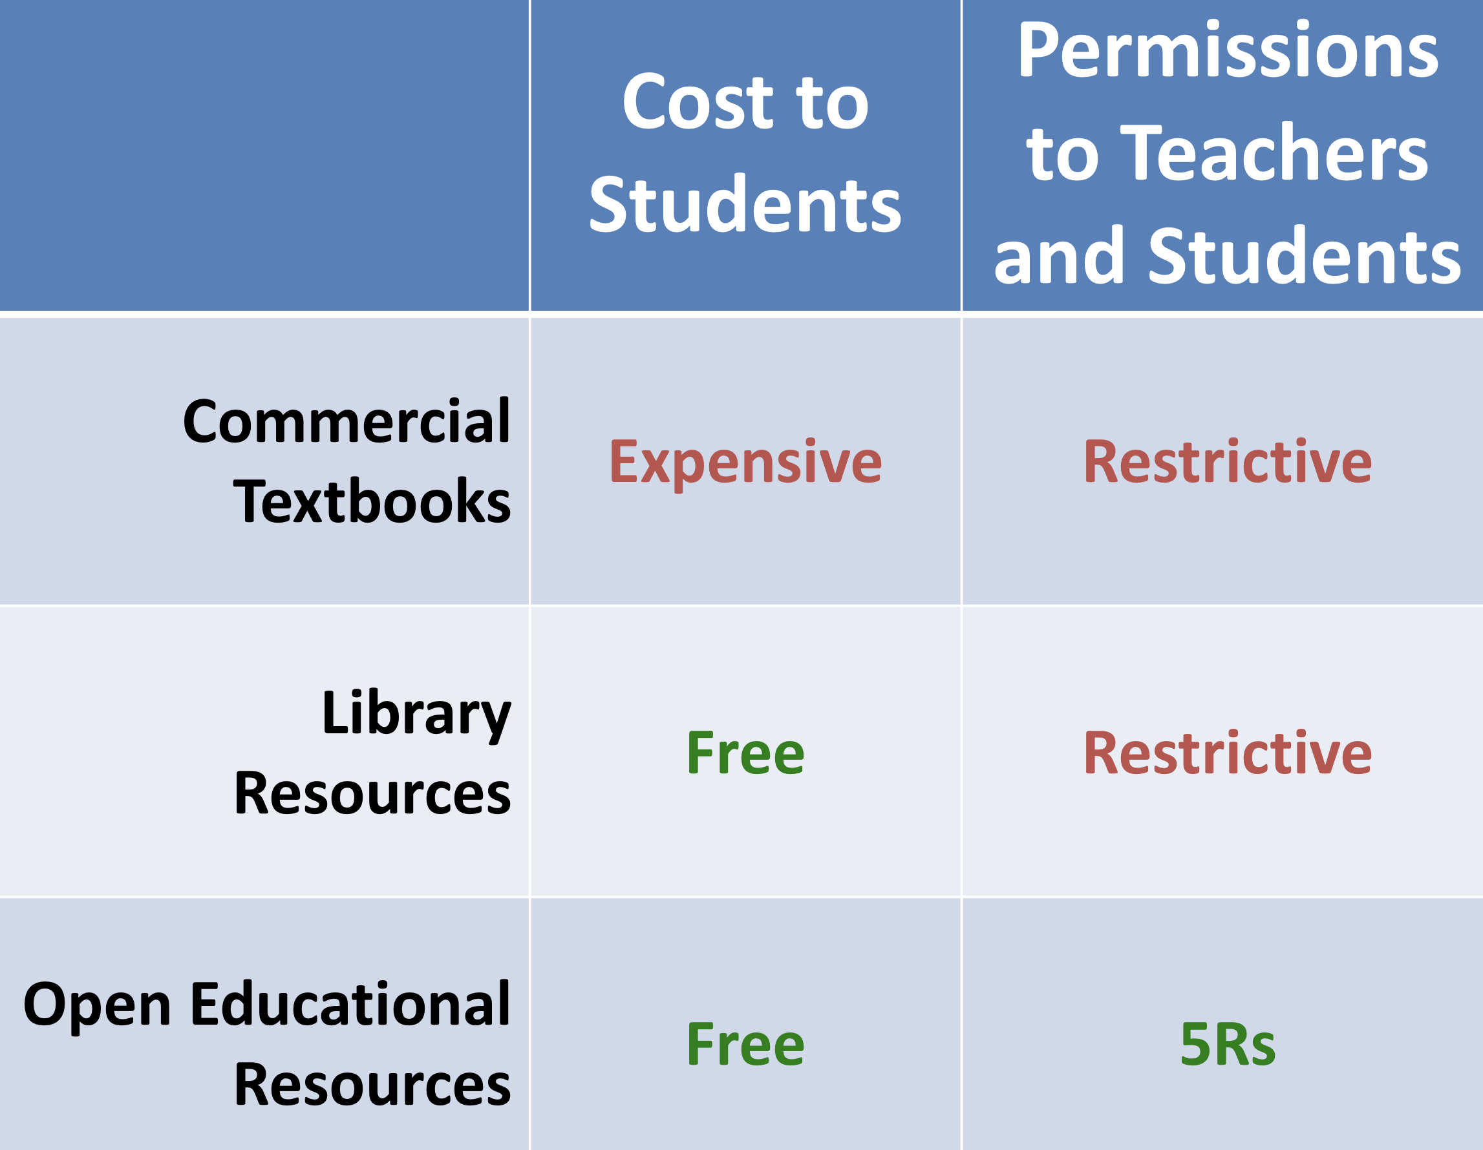
OPEN EDUCATION IN HEALTH PROGRAMS
OER vs. Free Library Resources
David Wiley. Slide. CC BY 4.0

Slide 13

جميع الحقوق محفوظة

Slide 14
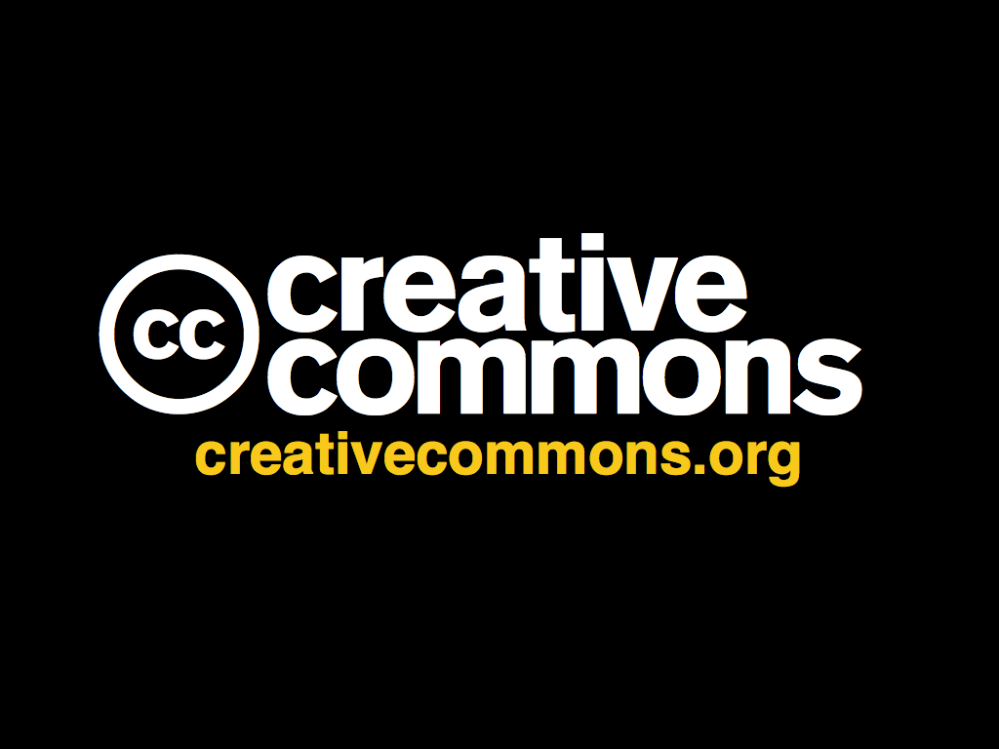

المشاع الإبداعي

Slide 15
OPEN EDUCATION IN HEALTH PROGRAMS
What is Creative Commons?
Creative Commons is a nonprofit organization that enables the sharing and use of creativity and knowledge through free legal tools.
Watch this short video, A Shared Culture, to get a sense for the vision behind Creative Commons. Shared Culture
Today, the CC licenses and public domain tools are used on more than 1.4 billion works, from songs to Youtube videos to scientific research. The licenses have helped a global movement come together around openness, collaboration, and shared human creativity.
المشاع الإبداعي هي مؤسسة غير ربحية تسعى لزيادة مشاركة المواد الإبداعية في مجالات متنوعة كالثقافة، التعليم، الفن و المحتوى العلمي من خلال تراخيص قانونية سهلة الفهم والإستخدام.
www.creativecommons.org

Slide 16




How Does Creative Commons Work?
OPEN EDUCATION IN HEALTH PROGRAMS
Step 1: Choose conditions
 | Attribution. You let people copy, distribute, display, perform, and remix your copyrighted work, as long as they give you credit the way you request. All CC licenses contain this property.
 | Non-Commercial. You let people copy, distribute, display, perform, and remix your work for non-commercial purposes only. If they want to use your work for commercial purposes, they must contact you for permission.
 | Share Alike. You let people create remixes and derivative works based on your creative work, as long as they only distribute them under the same Creative Commons license that your original work was published under.
 | No Derivative Works. You let people copy, distribute, display, and perform only verbatim copies of your work — not make derivative works based on it. If they want to alter, transform, build upon, or remix your work, they must contact you for permission.

Slide 17
How Does Creative Commons Work?
OPEN EDUCATION IN HEALTH PROGRAMS
Step 2: Get a License
 | Attribution
 | Attribution – Share Alike
 | Attribution – No Derivatives
 | Attribution – Non-Commercial
 | Attribution – Non-Commercial
 | Attribution – Non-Commercial– No Derivatives

Slide 18
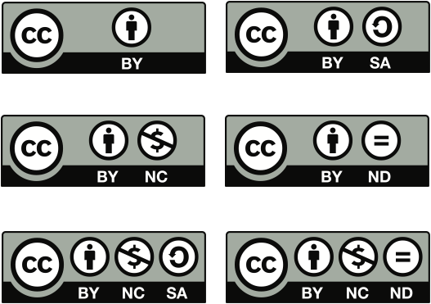
OPEN EDUCATION IN HEALTH PROGRAMS
Notes:
step 2 is to simply receive the license
there are 6 CC licenses that reflect a spectrum of rights
for the photos I share on Flickr, I use the Attribution only license, which means that anyone can download, copy, distribute, remix, tweak, and build upon them, even commercially, as long as they give me credit

Slide 19
OPEN EDUCATION IN HEALTH PROGRAMS
Using CC Licenses and CC-Licensed Works
The six Creative Commons licenses provide a range of options for creators who want to share their work with the public while still retaining copyright.
The best way to decide which license is appropriate for you is to think about why you want to share and how you hope others will use your work. Licensing_flowchart.pdf
You can use the CC License Chooser tool License_Chooser
If you want to apply CC0 to your work go to CC0

Slide 20
OPEN EDUCATION IN HEALTH PROGRAMS
Finding and Reusing CC-Licensed Work
Creative commons new search tool https://ccsearch.creativecommons.org/
Wikipedia: List_of_major_Creative_Commons_licensed_works
All CC licenses require that attribution be given to the creator and the best practice for attribution is applying the “TASL” approach. T = Title A = Author S = Source L = License
Examples of proper attribution Best_practices_for_attribution

Slide 21
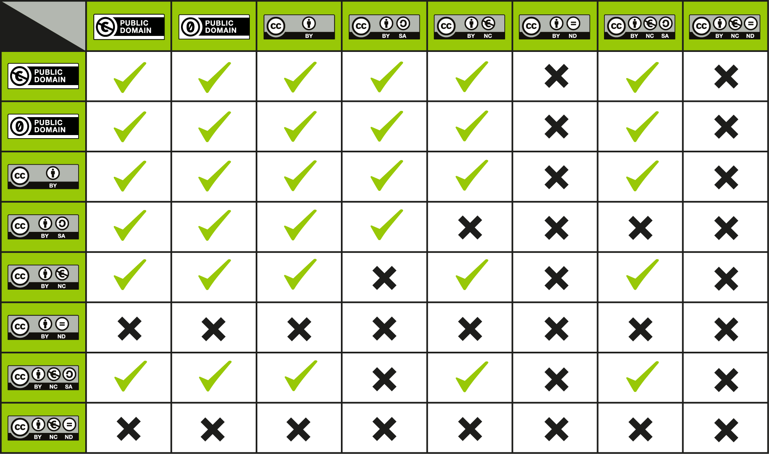

Slide 22
OPEN EDUCATION IN HEALTH PROGRAMS
License matching activity
Use this interactive license matching game to test your knowledge of Creative Commons licenses.
License Matching Activity
Video from Creative Commons for a brief overview of its
licenses and what they mean.

Slide 23
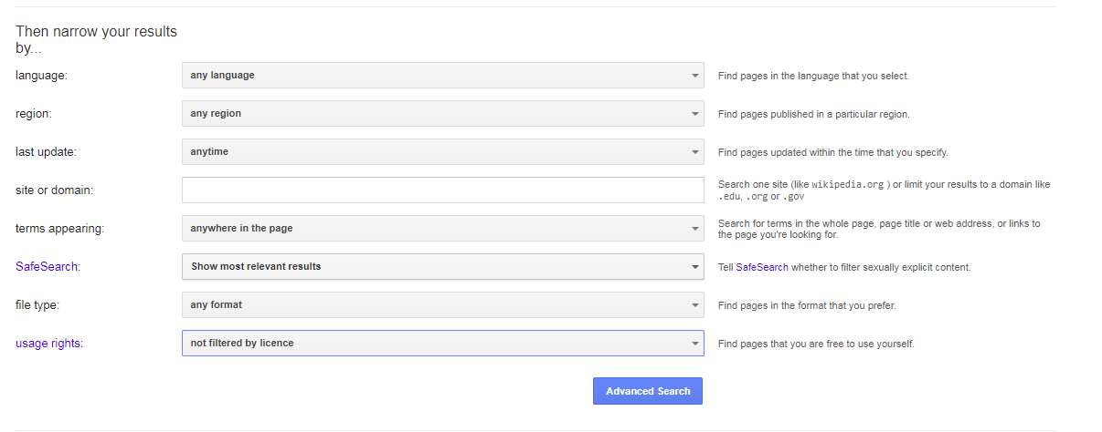
Google Advanced Search
OPEN EDUCATION IN HEALTH PROGRAMS

Slide 24
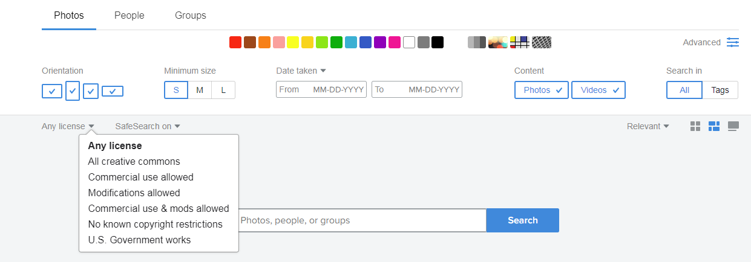
Flickr Advanced Search
OPEN EDUCATION IN HEALTH PROGRAMS

Slide 25
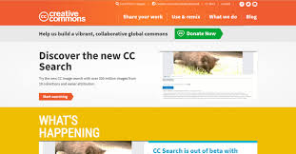
Creative Commons
OPEN EDUCATION IN HEALTH PROGRAMS

Slide 26
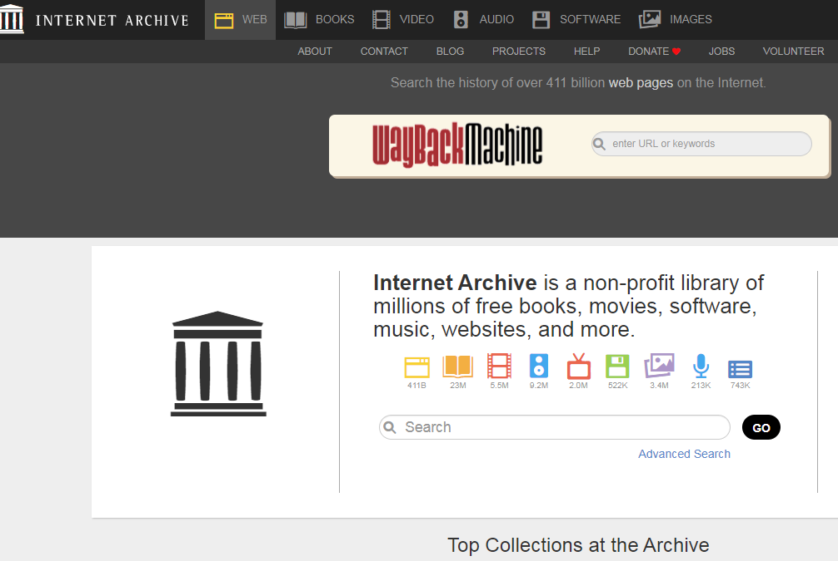
Internet Archive
OPEN EDUCATION IN HEALTH PROGRAMS

Slide 27
OPEN EDUCATION IN HEALTH PROGRAMS
Openstax
Publish high-quality, peer-reviewed, openly licensed college textbooks that are absolutely free online.

Slide 28
OPEN EDUCATION IN HEALTH PROGRAMS
MedPix
MedPix® is a free open-access online database of medical images, teaching cases, and clinical topics, integrating images and textual metadata including over 12,000 patient case scenarios, 9,000 topics, and nearly 60,000 images.

Slide 29
OPEN EDUCATION IN HEALTH PROGRAMS
Disease Info Search
A digital commons for the global health community containing documents, links, audio, and video files

Slide 30
OPEN EDUCATION IN HEALTH PROGRAMS
Public Library of Science (PLoS)
PLOS a nonprofit Open Access publisher, innovator and advocacy organization with a mission to advance progress in science and medicine by leading a transformation in research communication.

Slide 31
OPEN EDUCATION IN HEALTH PROGRAMS
Public Health Image Library
Photographs, illustrations, and
multimedia files in collections such as bioterrorism, natural disasters, and health behaviors

Slide 32
OPEN EDUCATION IN HEALTH PROGRAMS
MERLOT Health Sciences
MERLOT Health Sciences Portal, an educational resource for health professionals

Slide 33
OPEN EDUCATION IN HEALTH PROGRAMS
OER COMMONS
OER Commons – Health, Medicine and Nursing
OER Commons – Anatomy/Physiology
OER Commons – Biology
OER Commons – Genetics

Slide 34
OPEN EDUCATION IN HEALTH PROGRAMS
JHSPH Open CourseWare
Open public health courses and materials from The Johns Hopkins Bloomberg School of Public Health

Slide 35
OPEN EDUCATION IN HEALTH PROGRAMS
LibreTexts
A project to unite students, faculty and scholars in a cooperative effort to develop an easy-to-use online platform for the construction, customization, and dissemination of open educational resources (OER).

Slide 36
Open Education for Health Professionals
SKILLS COMMON
Free and open online library containing learning materials for job-driven workforce development.

Slide 37
Smithsonian
OPEN EDUCATION IN HEALTH PROGRAMS
Smithsonian Releases 2.8 Million Images + Data into the Public Domain Using CC0

Slide 38
OPEN EDUCATION IN HEALTH PROGRAMS
Principles of Research and Problem Solving
Introductory course in research methods and proposal writing.

Slide 39
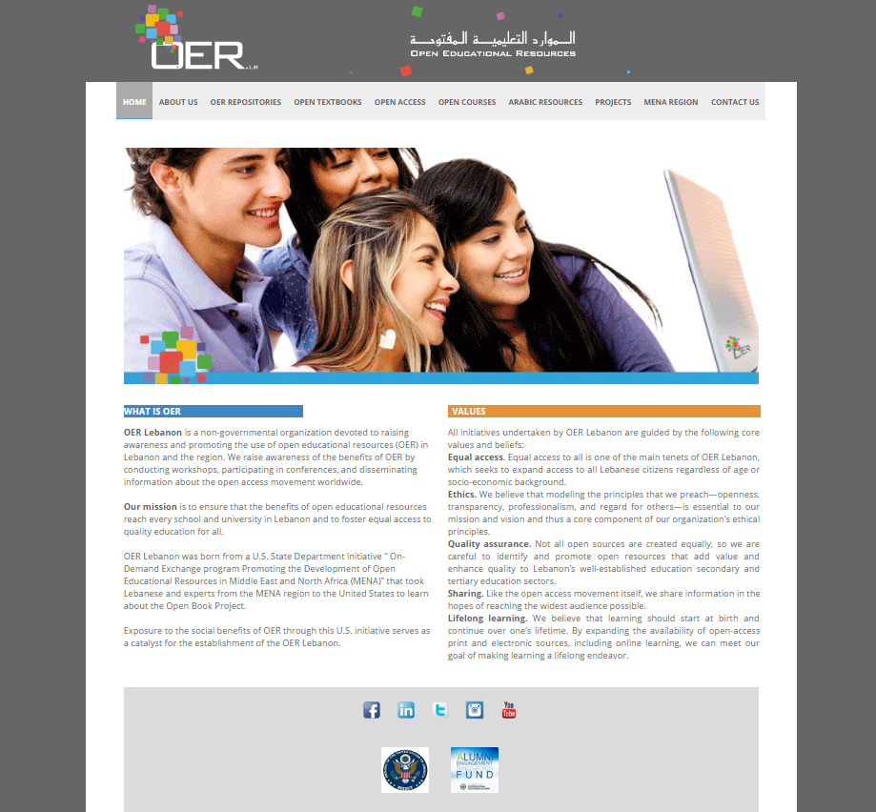

Slide 40
OPEN EDUCATION IN HEALTH PROGRAMS
When we Shift to OER
Access & Equity
Current, relevant, effective, quality content
Learning outcomes
Time to degree
Course drop out rate
Students become producers of knowledge
Knowledge is shared freely / globally

Slide 41
OPEN EDUCATION IN HEALTH PROGRAMS
Open Educational Resources @ NDU

Slide 42

OPEN IN HEALTH PROGRAMS
Thank You !
Twitter: @fbaroud
Email: fbaroud@ndu.edu.lb

