Slide 1
WP4 Q&A
Innovative digital skills and teaching methods for effective health education in Lebanon and Syria
UNIMED
30 October 2020

Slide 2
Highlights from the mid-term quality evaluation report
Evaluation period: 15 November 2018 - 14 September 2020
For the period under evaluation, the following evaluation activities have been carried out:
Evaluation of partners’ meetings
Kick-off meeting in Lebanon
Steering Committee meeting in Sweden
Partners’ survey – online questionnaire
Evaluation of Fields Visits and Training Workshops
Field visit and Training Workshop at the University of Genoa, Italy
Field visit and Training Workshop at the University of Santiago de Compostela, Spain
Training of Trainers at the Beirut Arab University, Lebanon

Slide 3
1.
Evaluation of partners’ meetings

Slide 4
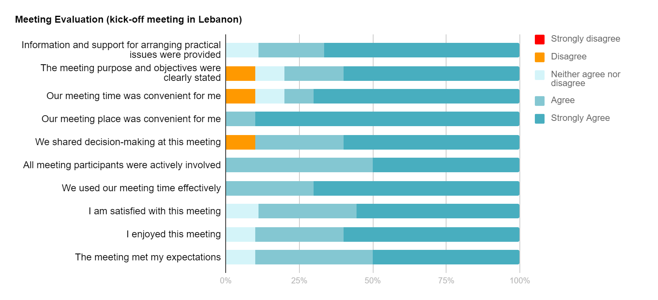
Kick off Meeting (Feb 28th - March 2nd 2019 - Beirut, Lebanon)

Slide 5
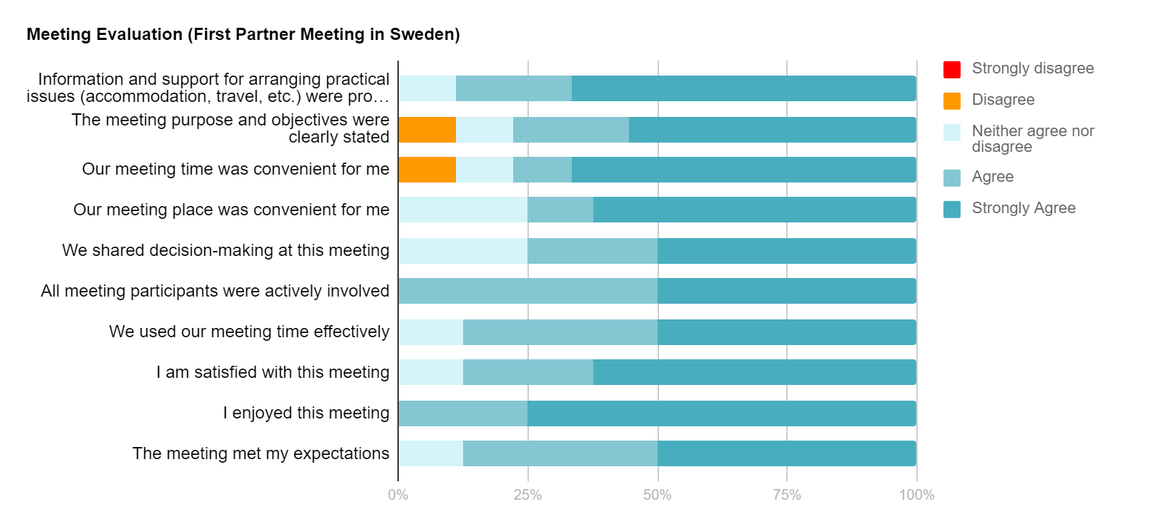
Steering Committee Meeting (27-30 Nov 2019, Sweden)

Slide 6
2.
Partners’ Survey

Slide 7
Relevance of the project

Slide 8
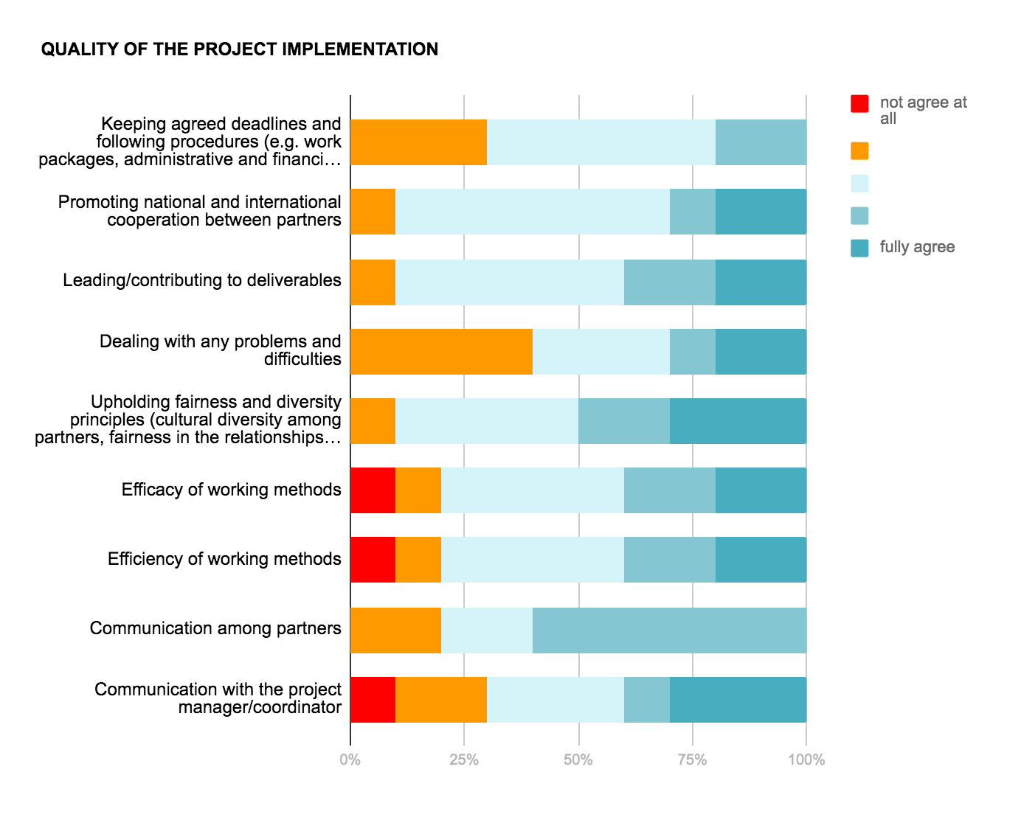
Quality of the project implementation

Slide 9
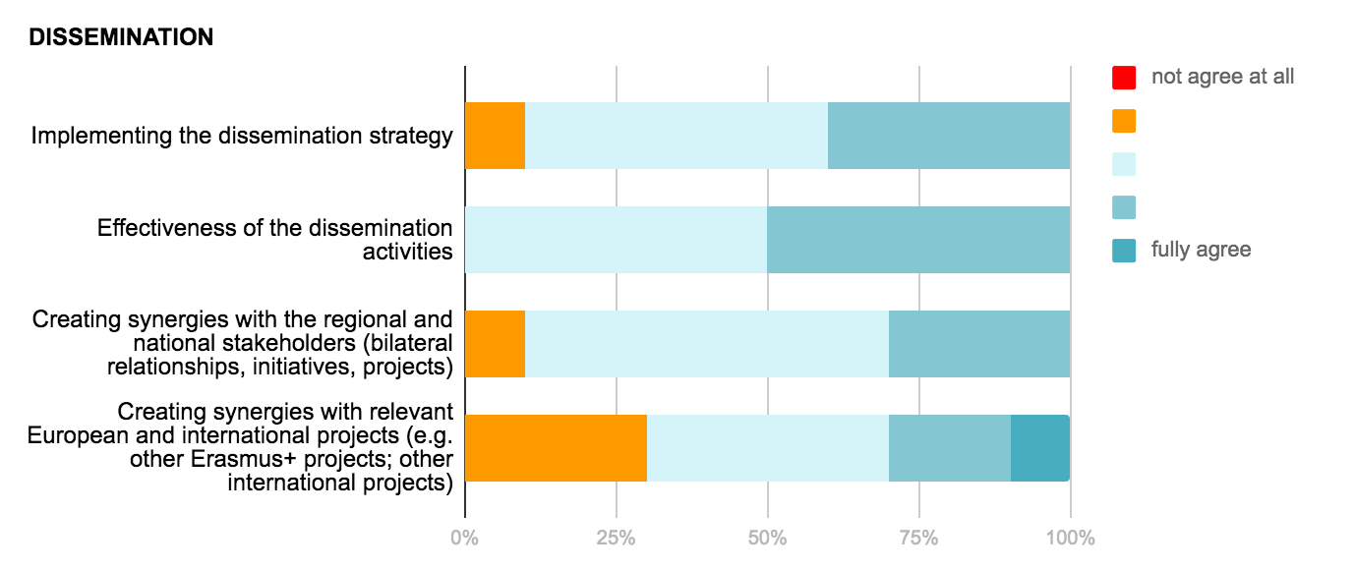
Dissemination

Slide 10
3.
Evaluation of Fields Visits and Training Workshops partners’ meetings

Slide 11
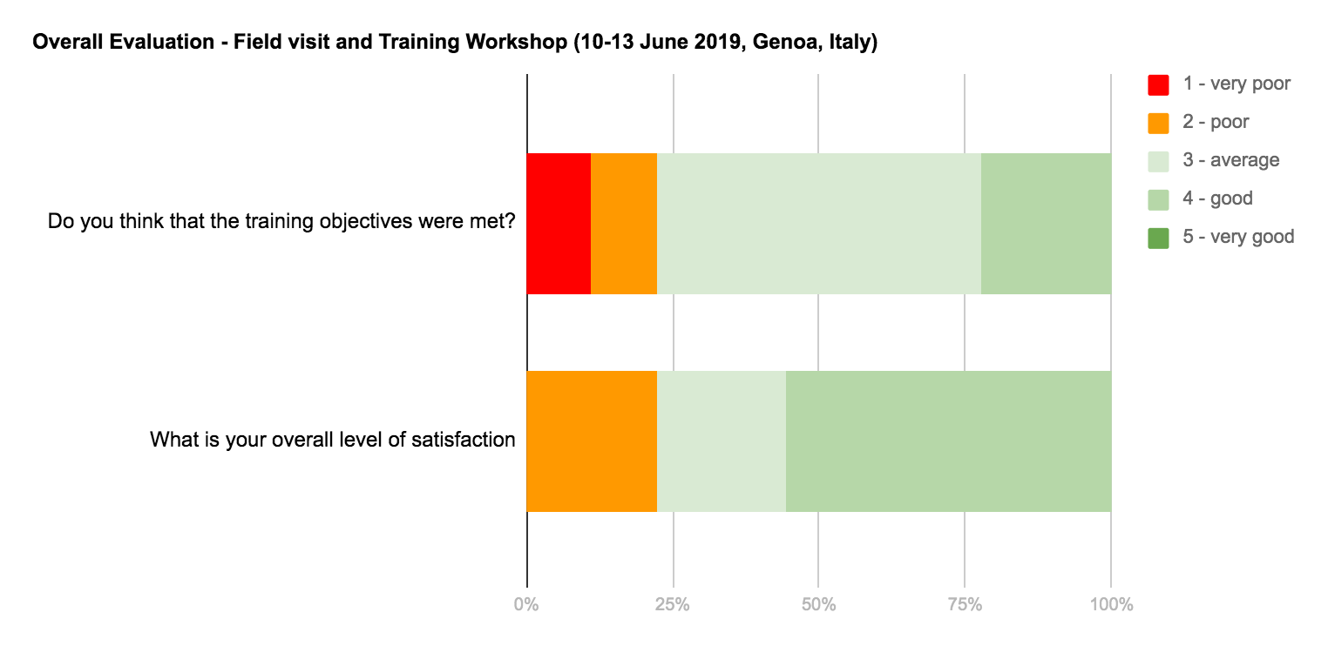
Field visit and Training Workshop (10-13 June 2019, Genoa, Italy)

Slide 12
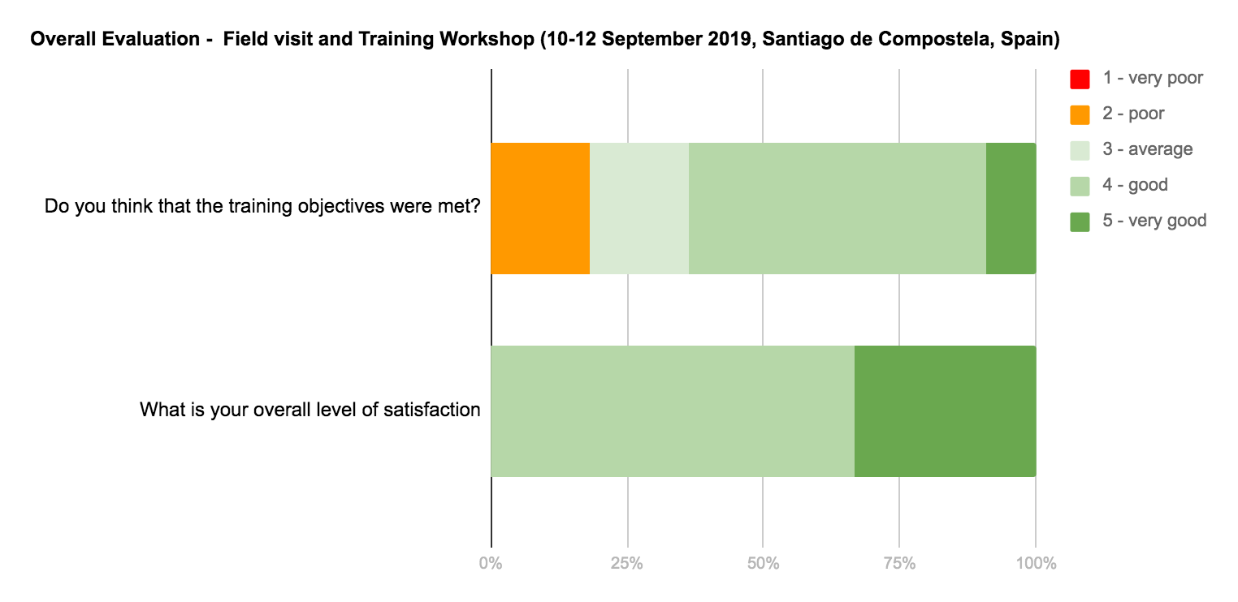
Field visit and Training Workshop (10-12 September 2019, Santiago de Compostela, Spain)

Slide 13
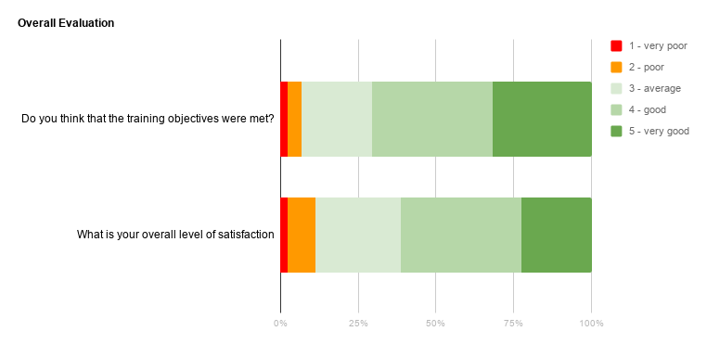
Training of Trainers (3-5 March 2020, Beirut, Lebanon)

Slide 14
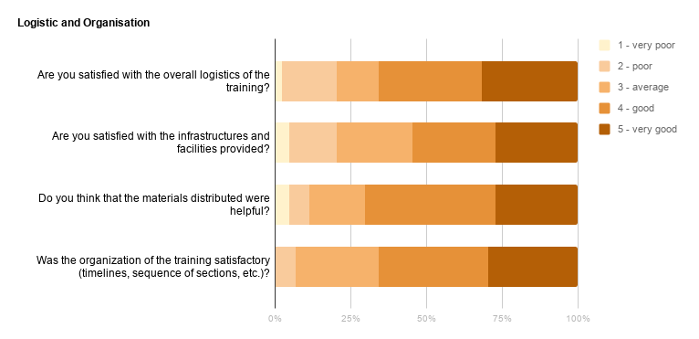
Training of Trainers (3-5 March 2020, Beirut, Lebanon)

Slide 15
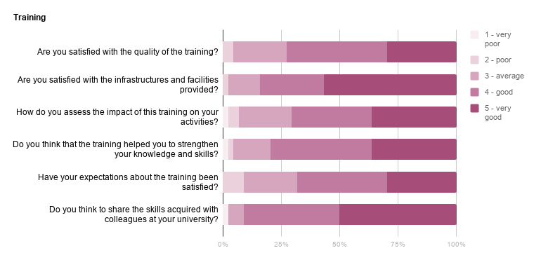
Training of Trainers (3-5 March 2020, Beirut, Lebanon)

Slide 16
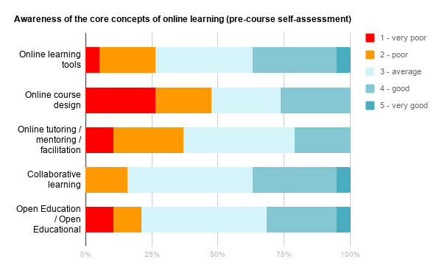
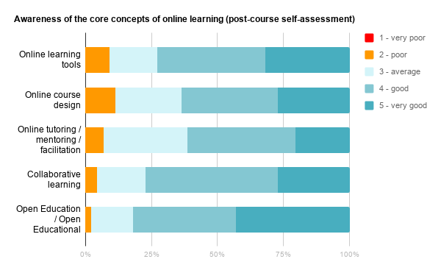
Training of Trainers: Development of competences (pre and post training self-assessment)

Slide 18
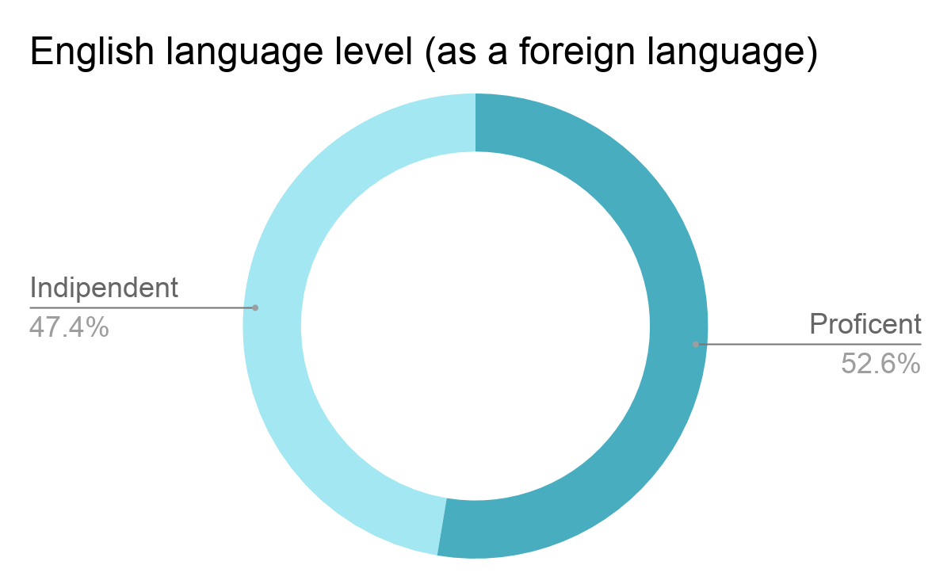
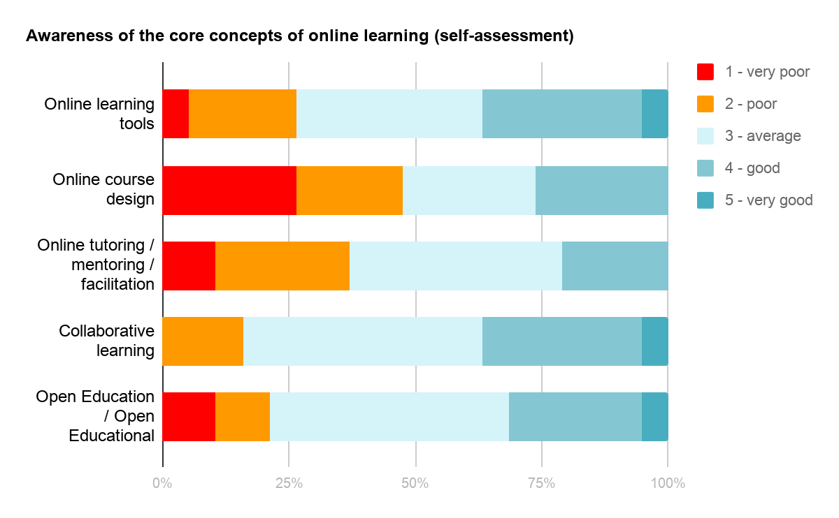
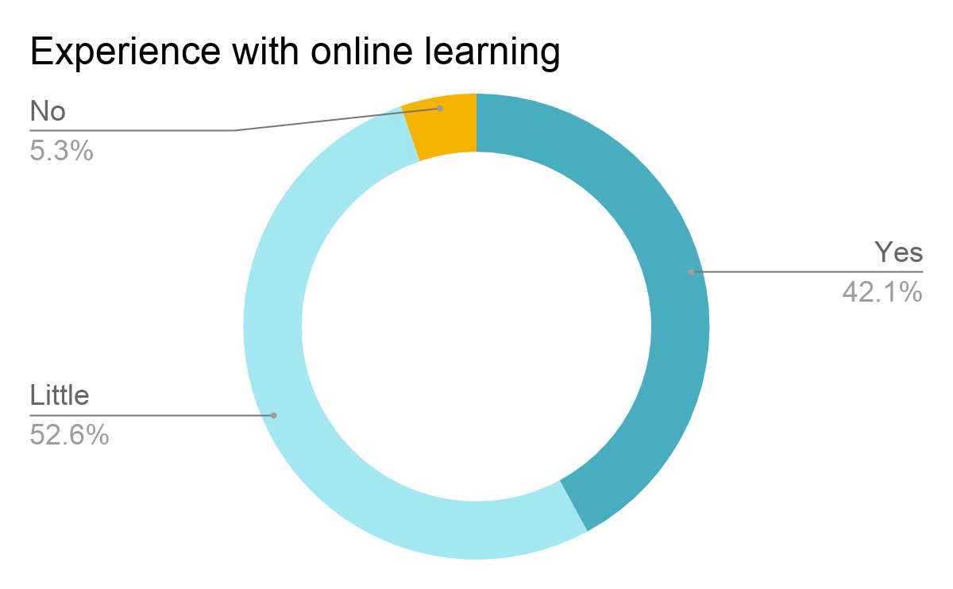
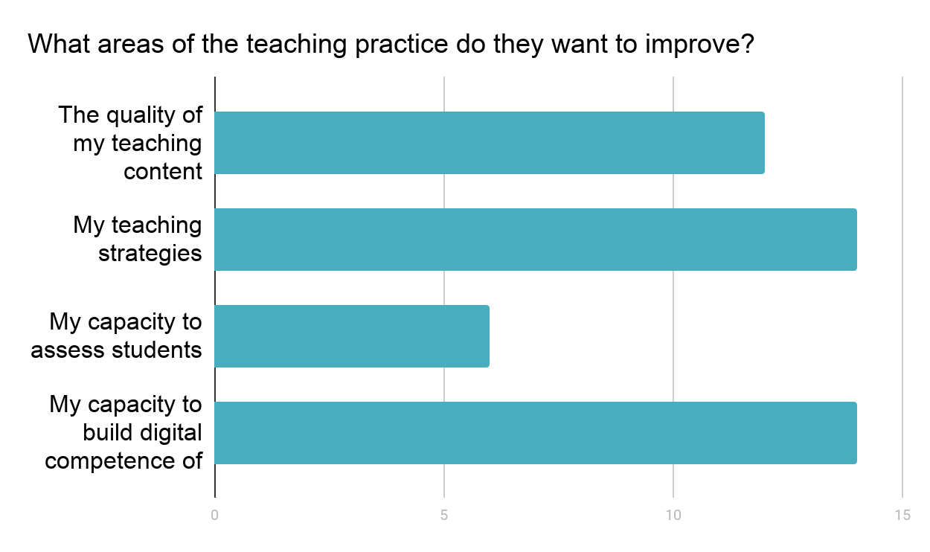
Participants’ profile
WHO THEY ARE
WHERE THEY COME FROM
44
participants
LEBANON | SYRIA
Lebanese University Beirut Arab University Lebanese International University Modern University for Business and Science | Damascus University Arab International University University of Hama
FEMALE
48%
MALE
52%
ONE
promising community
Training in Beirut, 3-5 March 2020

